Slide 1
Fourier Transform Infra-Red (FT-IR) SPECTROSCOPY
-An Introductory lecture

Slide 2
Application of FTIR
Infrared Spectroscopy
(IR or FTIR)
Deals with the interaction of molecules with the Infra-red region of the electromagnetic radiation.
When molecules absorb infrared radiation of a certain energy, their bonds vibrate (stretch, contract, bend, wiggle, twist, etc.).
We can measure how much energy is absorbed at each particular wavelength and make inferences about the types of bonds that are present in the molecule.
Drug Identification
Fiber Analysis
Paint Analysis
Ink and Dye Analysis
Paper Analysis

Slide 3
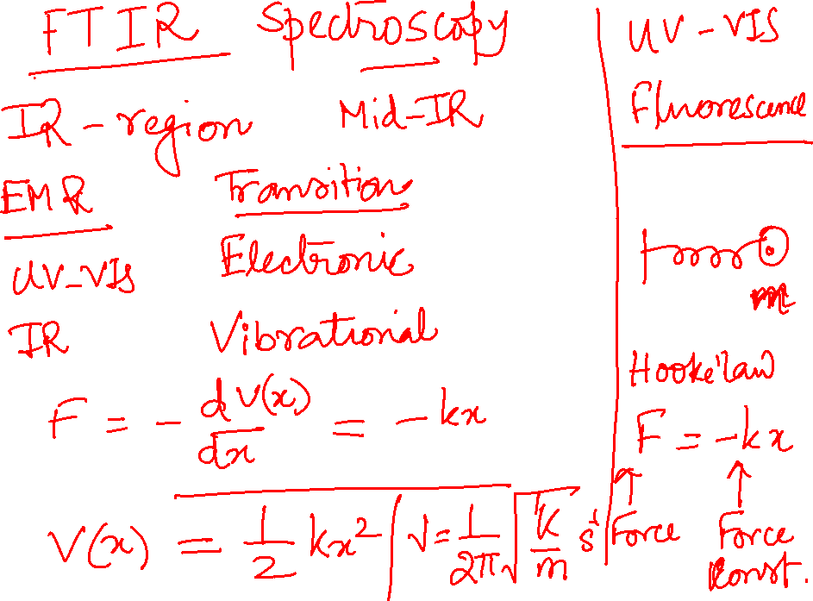

Slide 4
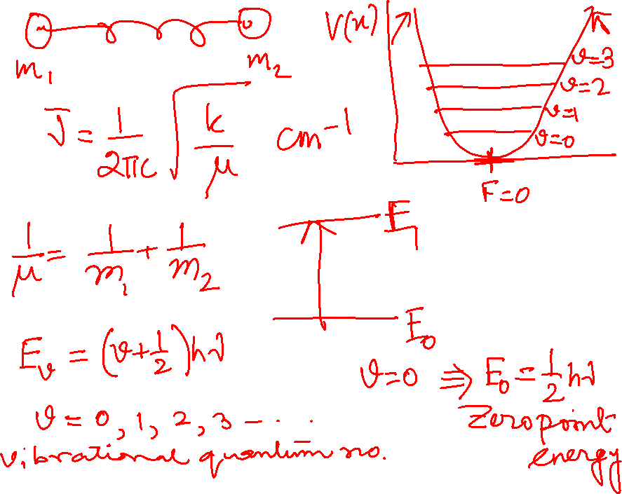

Slide 5
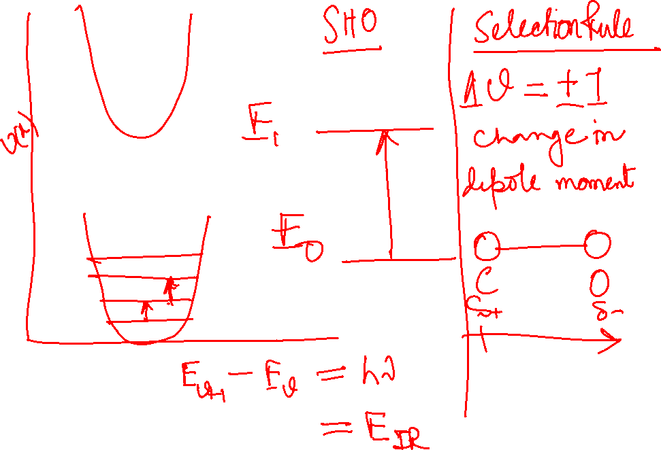

Slide 6
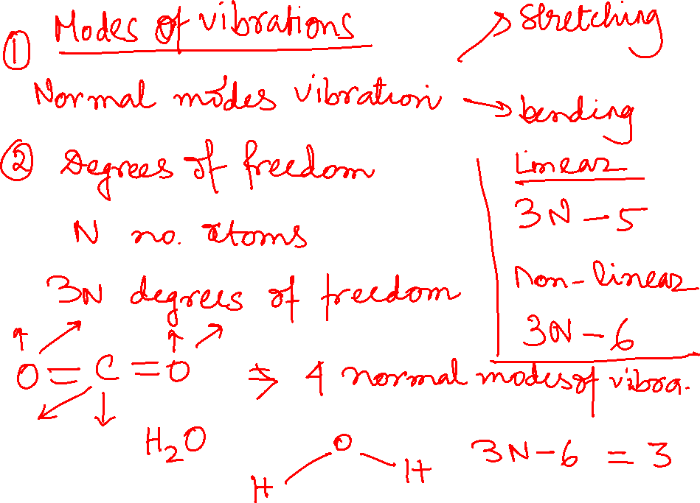

Slide 7
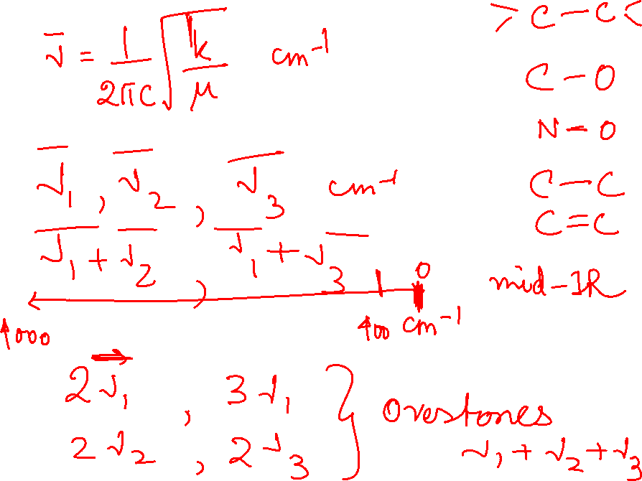

Slide 8
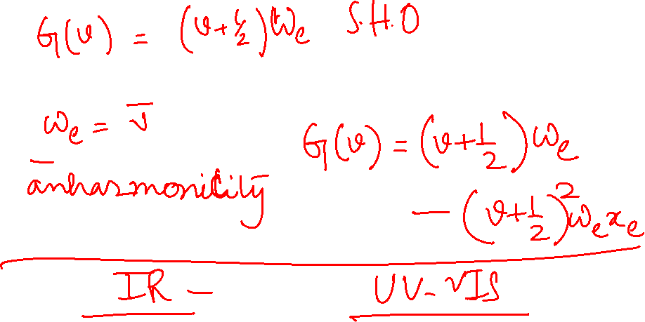

Slide 9
Advantages of FTIR
Non-destructive analysis technique
Rapid
Amenable to solids, liquids, gases, solutions, and irregular solids
Amenable to organics and inorganics, though primarily used for organics
Provides a confirmatory (Category A) test
Information FTIR Offers
Identification of pure compounds
Identification of structural features and functional groups present
Discrimination between salt and free base forms of drugs
Discrimination between stereoisomers

Slide 10
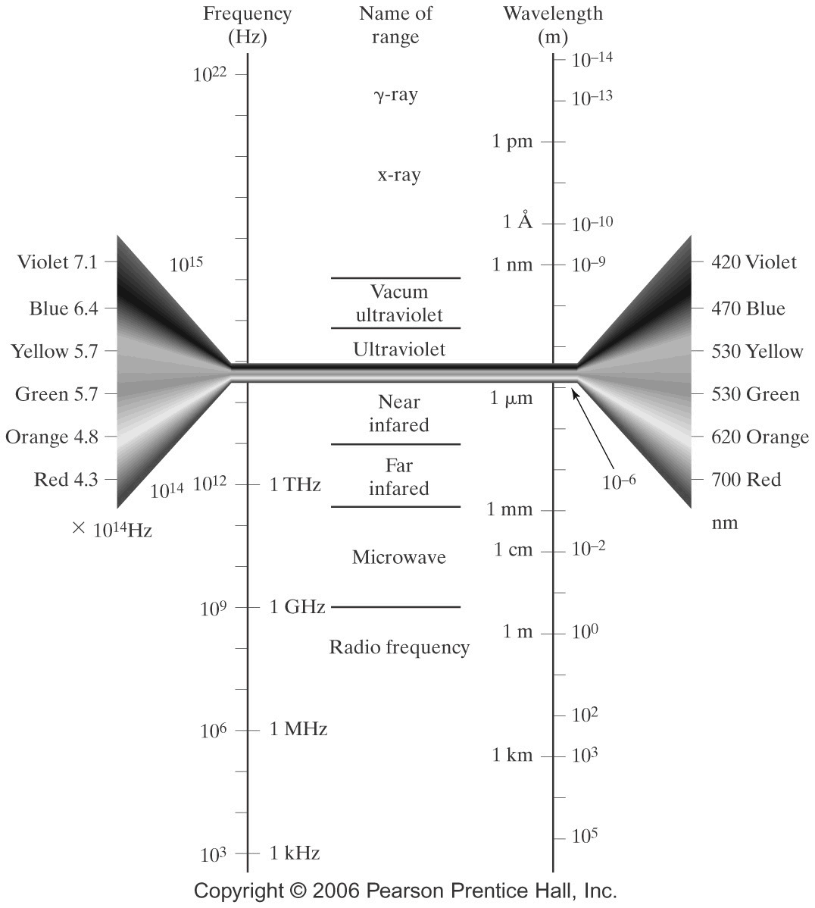
12820 ~ 4000 cm⁻¹
Mid-IR 400~4000 cm⁻¹
400 ~ 33 cm⁻¹

Slide 11
Region of infrared that is most useful lies between
2.5-16 mm (4000-625 cm⁻¹)
“Fingerprint region”: 600 ~ 1400 cm⁻¹
1600 ~ 3500 cm⁻¹ : functional group region
depends on transitions between vibrational energy states;
The types of vibration:
  stretching
  bending

Slide 12
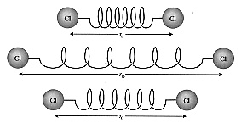
How IR Works
A Model: Picture the atoms of a diatomic molecule as point masses connected by springs (bonds).
As a first approximation use Hooke’s Law
F = -kx
F = force, restoring back to equilibrium position
k = characteristic stretching constant
x = displacement from the equilibrium position

Slide 13
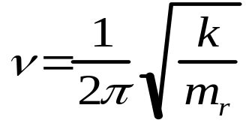
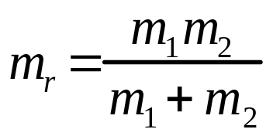
Diatomic system as Simple Harmonic oscillator
IR Stretching Frequencies of two bonded atoms:
What Does the Frequency, ν, Depend On?
= frequency
k = spring strength (bond stiffness)
m_{r} = reduced mass (~ mass of largest atom)
In real chemical bonds oscillations are not of harmonic nature
Anharmonicity is introduced considering Morse potential
Refer to any Physical Chemistry Book to read on Morse potential and
degrees of freedom for vibrational modes of molecule.

Slide 14
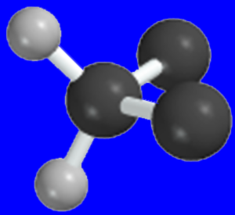
Stretching Vibrations of a CH₂ Group
Symmetric
Antisymmetric
(Asymmetric)

Slide 15




Bending Vibrations of a CH₂ Group
In plane
Bending Vibrations of a CH₂ Group
Out of plane

Slide 16
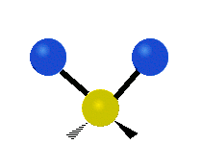
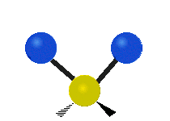
Bond Stretching
symmetric asymmetric

Slide 17



Bending
 | In-plane | Out-of-plane
Symmetric
Asymmetric
 | In-plane | Out-of-plane
Symmetric
Asymmetric
scissoring
wagging
rocking
twisting

Slide 18
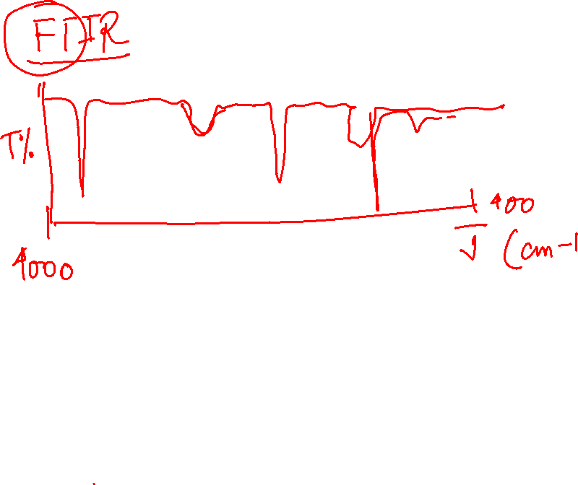

Slide 19
Factors affecting vibrational frequencies

Slide 20

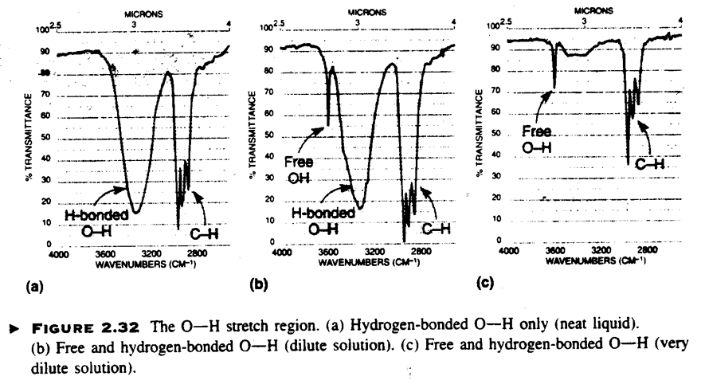
Alcohols and Phenols
Effect of Hydrogen bonding
O-H Free : Sharp 3650-3600
O-H H-Bond : Broad 3400-3300
Intermolecular Hydrogen bonding Increases with concentration
=> Less “Free” OH

Slide 21
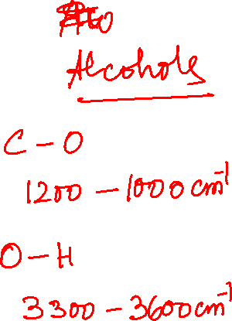
IR: Alcohols and Phenols
C-O : 1260-1000 cm⁻¹ (coupled to C-C => C-C-O)
C-O Vibration is sensitive to substitution:
Phenol 1220
3` Alcohols 1150
2` Alcohols 1100
1` Alcohols 1050
More complicated than above: shift to lower Wavenumber
With unsaturation (Table 3.2)

Slide 22
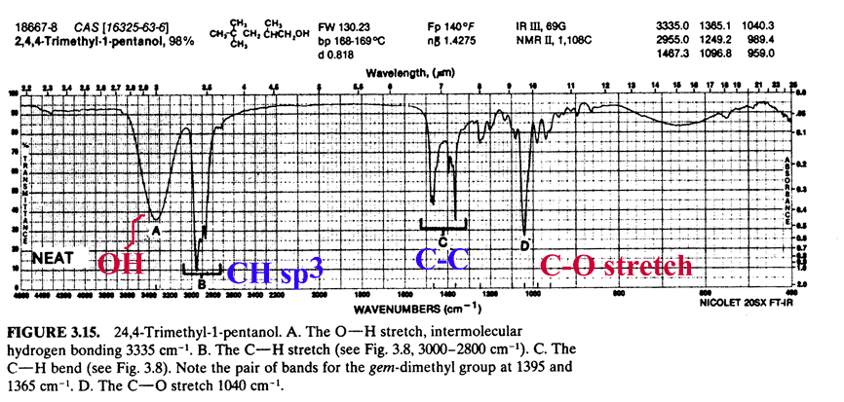
Alcohol
C-O : 1040 cm⁻¹ indicate primary alcohol

Slide 23

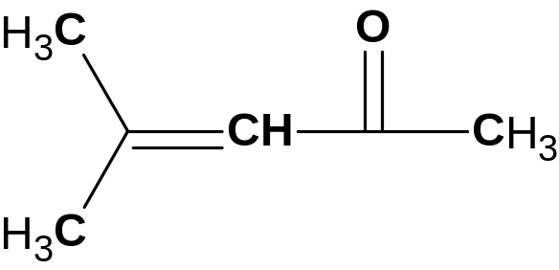
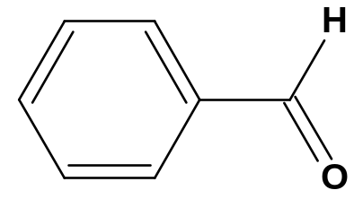
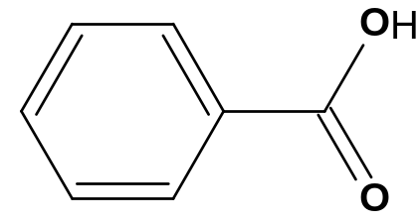
Carbonyl
Electronic Effect
From 1850 – 1650 cm⁻¹
1810
Anhydr
Band
1800
Acid
Chloride
1760
Anhydr
Band 2
1735
Ester
1725
Aldehyde
1715
Ketone
1710
Acid
1690
Amide
Ketone 1715 cm⁻¹ is used as reference point for comparisons
Factor influencing C=O
O
O⁻
1) conjugation
C
C
C=C
C⁺—C
Conjugation increase single bond character of C=O
➔ Lower force constant ➔ lower frequency number
1715 ➔1690
1725 ➔ 1700
1710 ➔1680

Slide 24
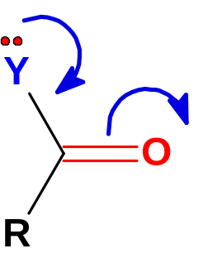
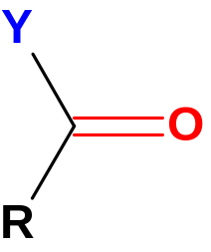
Effect of Heteroatom
Inductive effect
Resonance effect
Weaker bond
Lower frequence
Stronger bond
higher frequency
e.g. ester
e.g. amides
Y
C=O
Cl
1815-1785
Br
1812
inductive
OH (monomer)
1760
OR (Ester)
1705-1735
NH2
1695-1650
resonance
SR
1720-1690

Slide 25
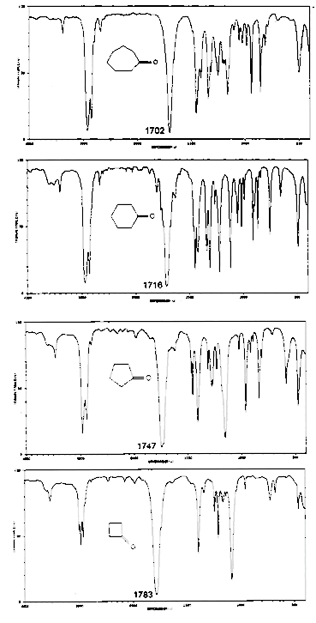
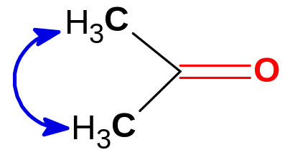
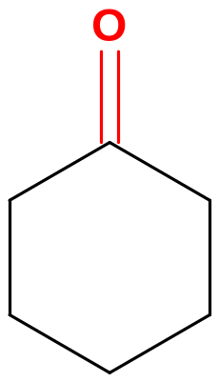
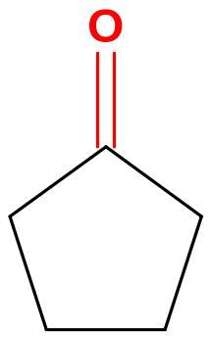
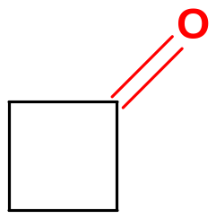
Ketone and Ring Strain
Effect of bond angle
Factors influencing C=O
2) Ring size
1715 cm⁻¹
1751 cm⁻¹
1775 cm⁻¹
Angle ~ 120º
< 120º
<< 120º
Ring Strain: Higher
ν

Slide 26
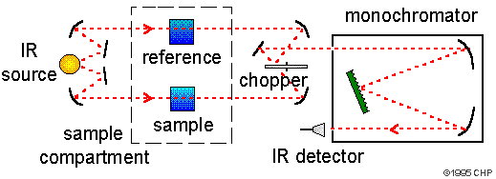
Dispersion IR spectrometer
Scanning or grating spectrometer
Light from the source passes through reference and sample channel.
Chopper is used to moderate energy reaching the detector.
The monochromator consists of a diffraction grating and a slit that allows one wavelength at a time to reach the detector.
The slit monitors the spectral bandwidth and the grating is moved to select each wavelength to be detected.

Slide 27
Components
FT-IR Instrument
Source
Michelson Interferometer
Sample
Detector

Slide 28
Sources
Black body radiators
Inert solids resistively heated to 1500-2200 K
Max radiation between 5000-5900 cm⁻¹ (2-1.7 mm), falls off to about 1 % max at 670 cm⁻¹ (15 mm)
Nernst Glower – cylinder made of rear earth elements
Globar- SiC rod
CO₂ laser
Hg arc (Far IR), Tungsten filament (Near IR)

Slide 29
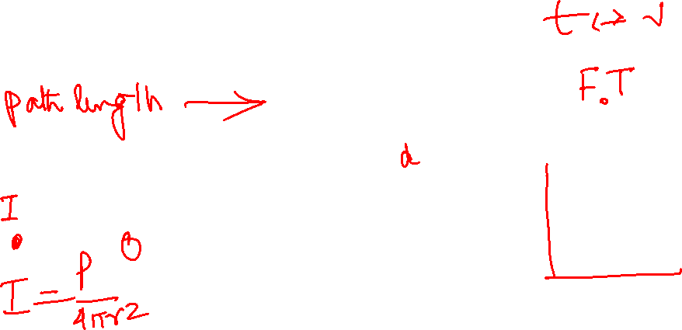
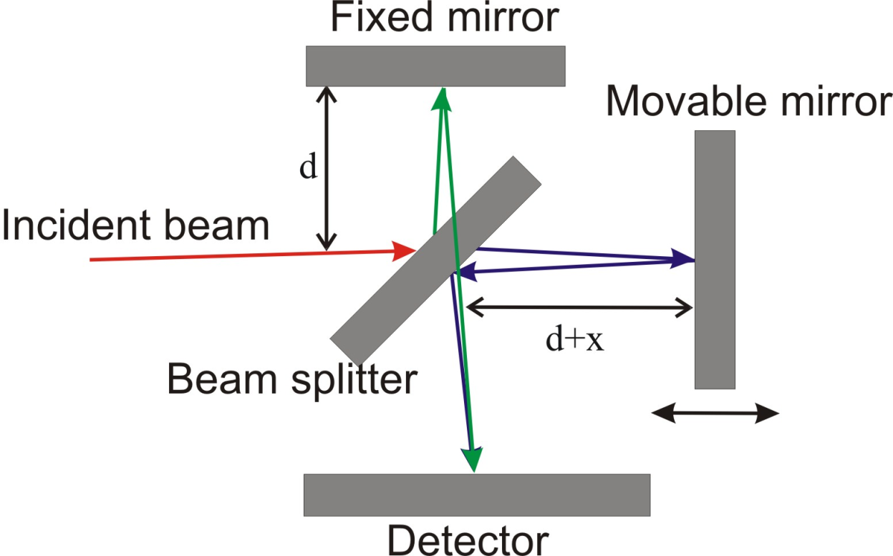
Michaelson Interferometer
FTIR spectrometer
Beam splitter
Stationary mirror
Moving mirror at constant velocity
Motor driven Micrometer screw
He/Ne laser; sampling interval, control mirror velocity

Slide 30
How does FTIR spectrometer works?
Light from the source passes through beam splitter which splits the light in to two halves.
One half is reflected to a fixed mirror and the other half is transmitted to a moving mirror.
The moving mirror moves back and forth with a constant velocity.
The two beams are reflected from the mirrors and recombined at the beam splitter.
The beam coming from the moving mirror has traveled a different path length.
The beams are combined to created interference pattern – interferogram
This interferogram goes from the beam splitter to the sample.
The sample absorbs and transmit the energy – detector detects.

Slide 31
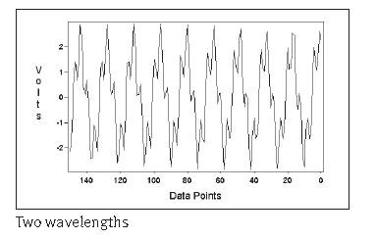
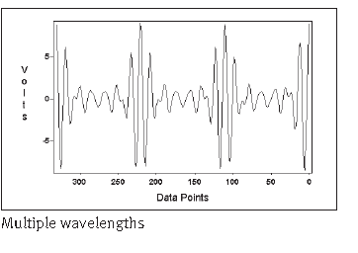
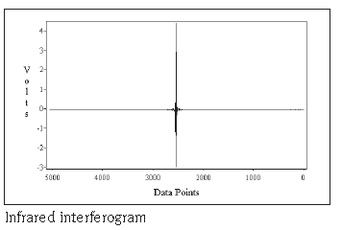
Interference patterns

Slide 32
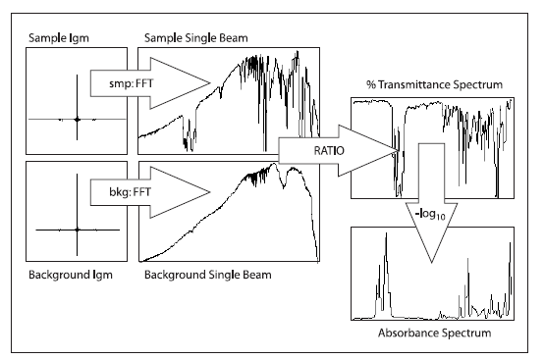
10¹⁴ Hz is too fast for the rapid changes in power to be directly measured as a function of time.
Can not measure the FID signal directly
Interferometer creates a replicate interference pattern at a frequency that is a factor of 10¹⁰ times slower
10⁴-10⁵ Hz can be measured electronically
f = (2v_{m}/c)n = 10⁻¹⁰n, v_{m} = 1.5 cm/s

Slide 33
Advantages of FTIR over Dispersion IR
Three major advantages
Multiplex advantage – every stroke of the moving mirror in the interferometer equals one scan of the entire Infrared spectrum - more no. of scan can be accumulated.
Throughput advantage - no use of slit – all wavelength reaches the sample and the detector – uses fewer mirror surfaces – less loss in energy due to reflection - signal to noise ratio much higher.
Precision advantage - laser is used to control the velocity of moving mirror – time the collection data point throughout the mirror stroke length of each scan – laser wavelength is a constant value and the x-axis data points are referenced to this value.

Slide 34
Sample
Sample holder must be transparent to IR- salts
Liquids
  Salt Plates
  Neat, 1 drop
  Samples dissolved in volatile solvents- 0.1-10%
Solids
  KBr pellets
  Mulling (dispersions)
Quantitative analysis-sealed cell with NaCl/NaBr/KBr windows

Slide 35
Setting up an experiment
Factors we can control
  Spectral Resolution
  Number of scans averaged
  These combine to determine the overall time required to collect a spectrum
  Signal/Noise ratio a N^{1/2}
  If S/N ratio is 3 for 1 scan, you can expect the S/N to increase to 30 if you collect and average 100 scans

Slide 36
Analysis of IR spectrum

Slide 37
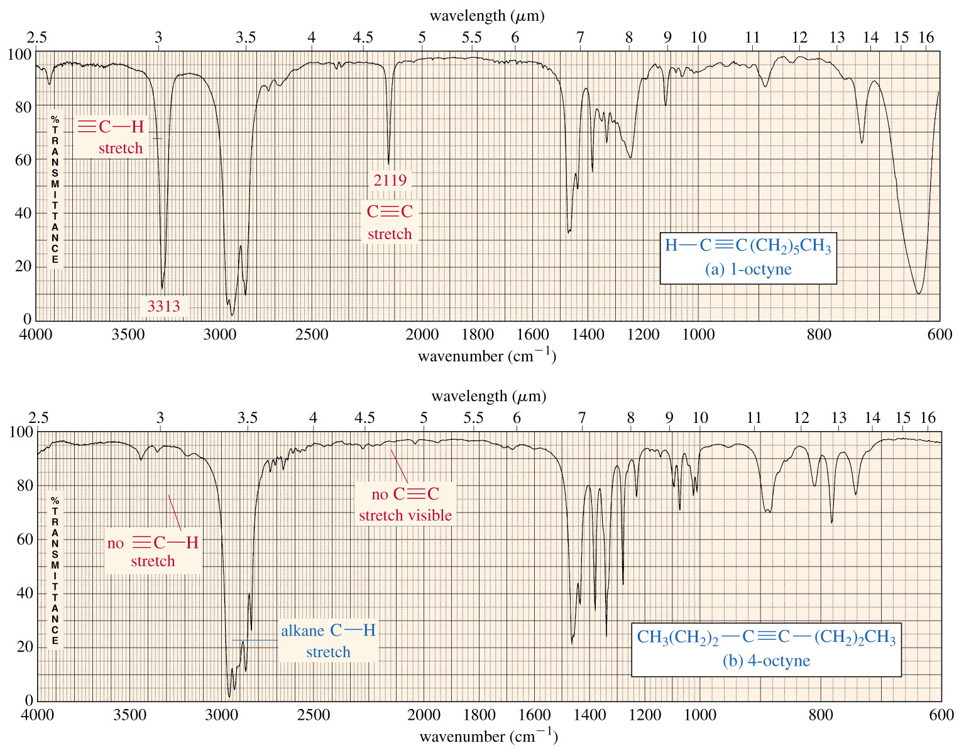

Slide 38
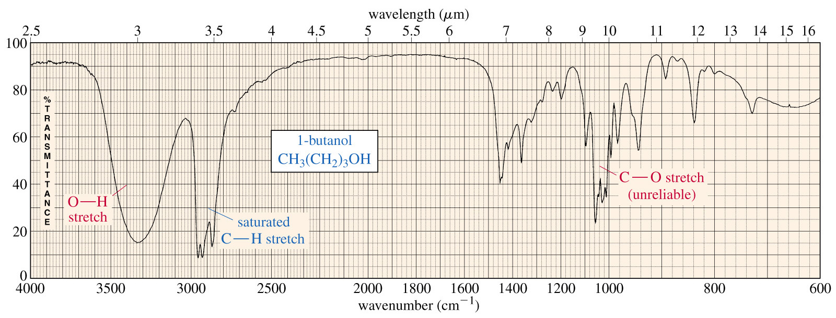
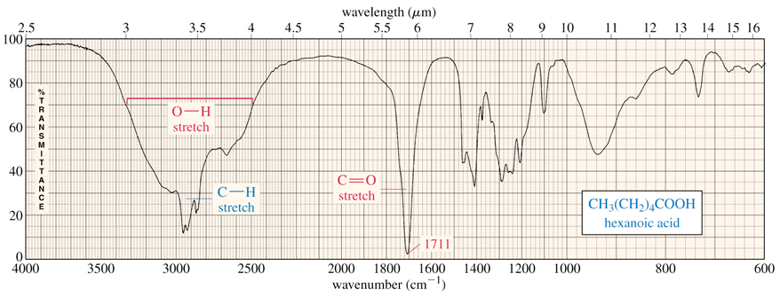
What is it?
What is it?

Slide 39
